Slide 1
Project Proposal: Automated Cell Counting For Hemocytometer Images

Slide 2
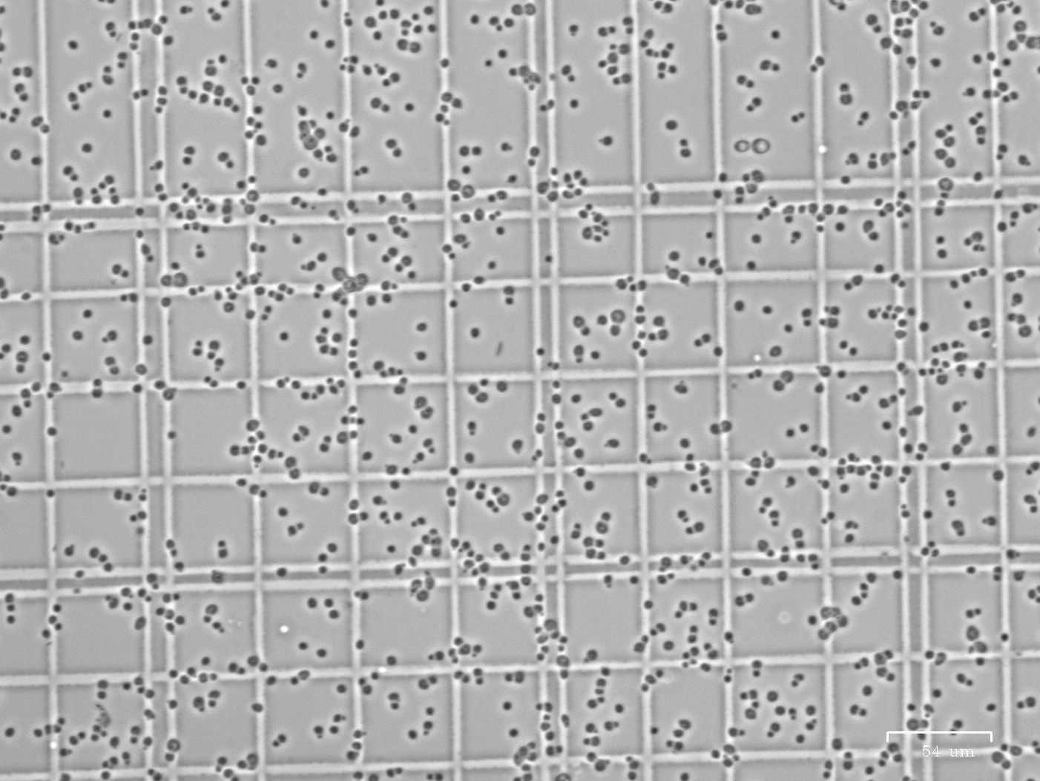
Issue: manual cell counting
Manual cell counting
Time-consuming
Inaccurate sometimes due to improper dilution factor.
Need cell count to estimate dilution
Improper dilution leads to inaccurate cell count
Trade-off between accuracy and efficiency
Not properly diluted sample

Slide 3
Proposal: Automated cell counting based on clustering algorithm
Time saving
Doesn’t require fancy equipment (automated cell counter)
Gives accurate cell count approximation based on wider range of dilution
Similar product: cell profiler
Other functions that are not needed for this particular lab purpose.
Need to adjust parameter to initiate.
Haven’t check the code out, but it’s online.
https://github.com/CellProfiler/CellProfiler-Analyst

Slide 4
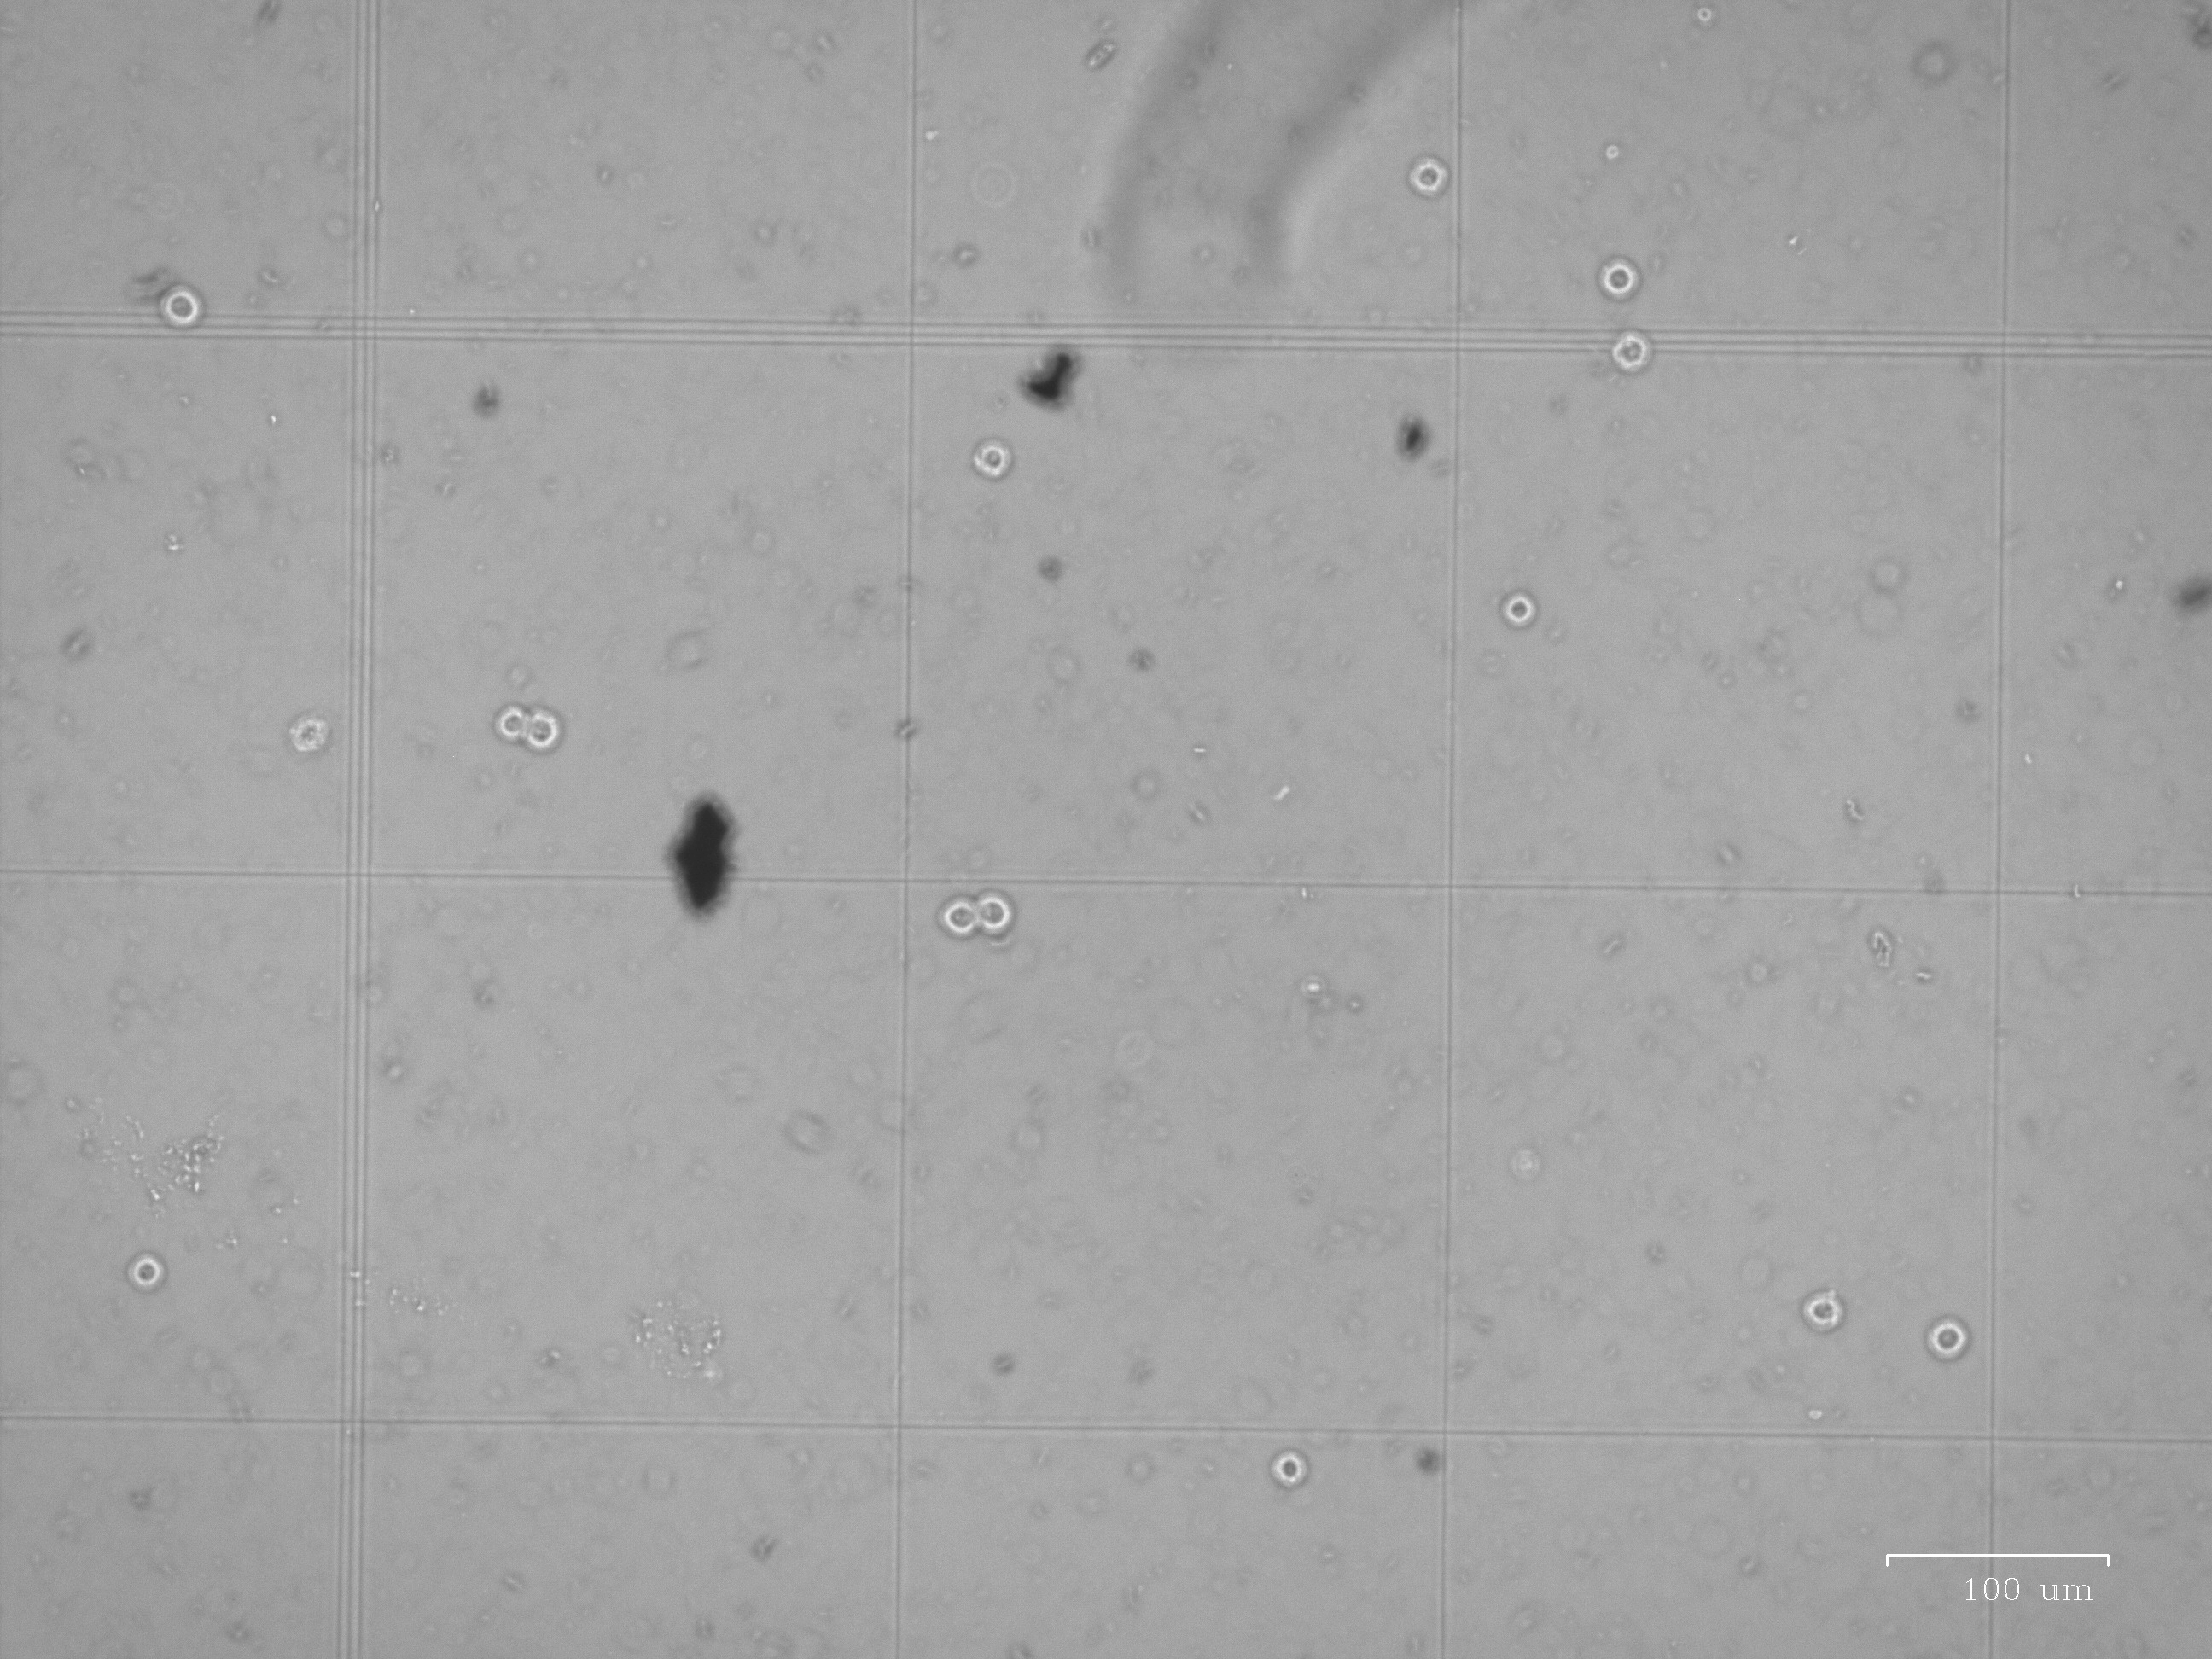
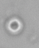
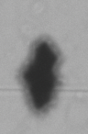
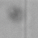
Identified problems
Differentiate viable cells from other contaminants and dead cells
Viable cells
Contaminants
Dead cells

Slide 5
Identified problems
Counting for clustered cells

Slide 6
Quick thoughts by Nicole
May consider invert the color first. (255*ones(size) - X)
Cluster by density
Identify small circles formed by the dye around viable cells.
Identify number of clusters
Radius first can be specified as user input, as normally it is a known parameter.
To develop a new feature, radius can be found by

Slide 7
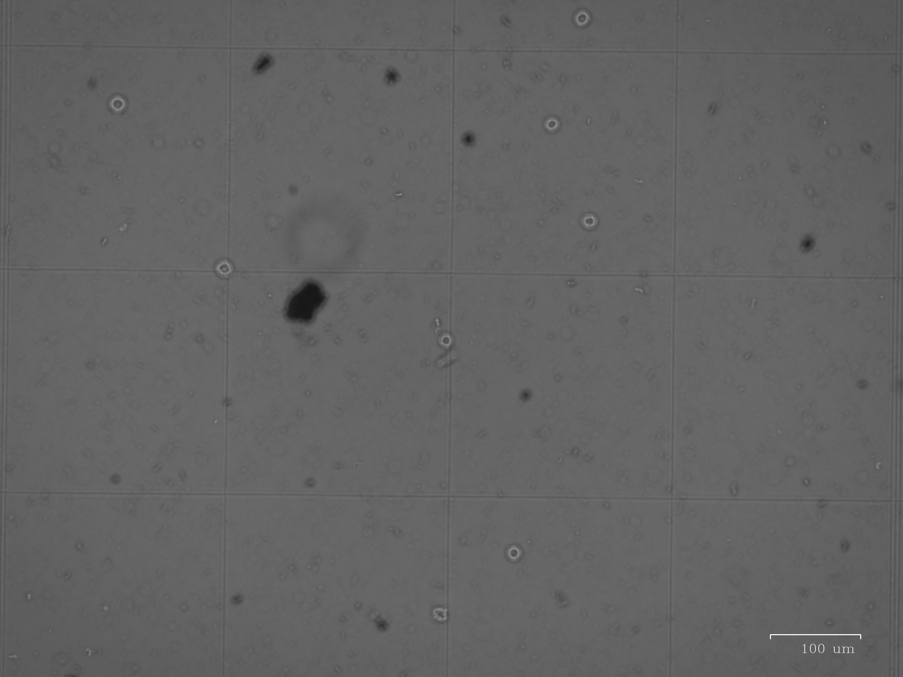
Other pictures (original picture)

Slide 8
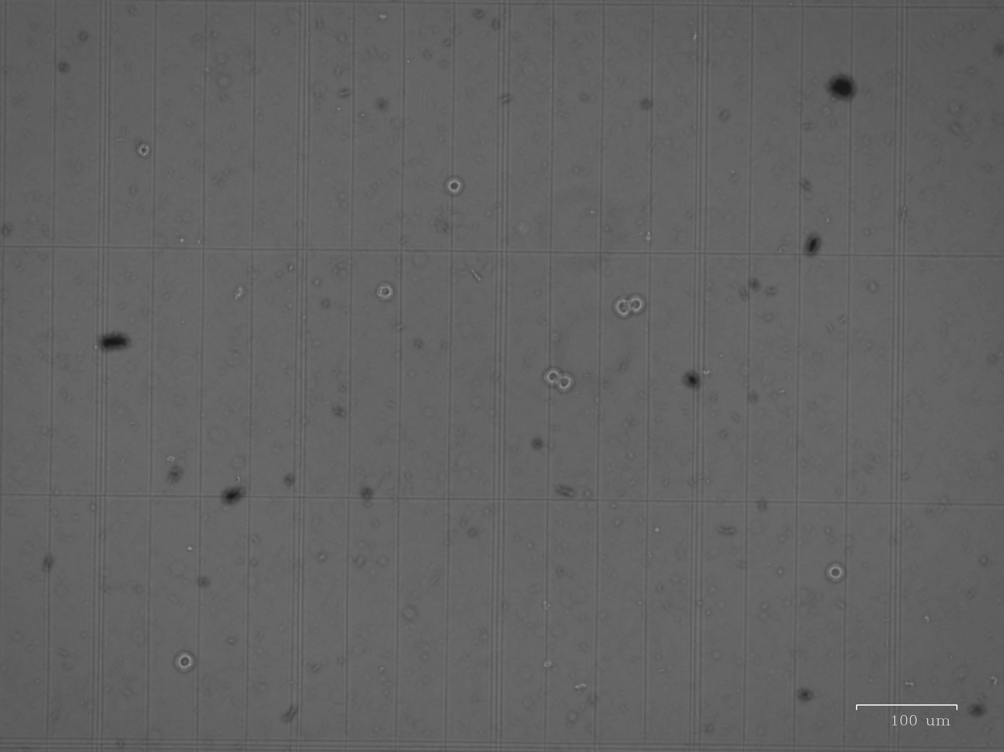
Other pictures (original picture)

Slide 9
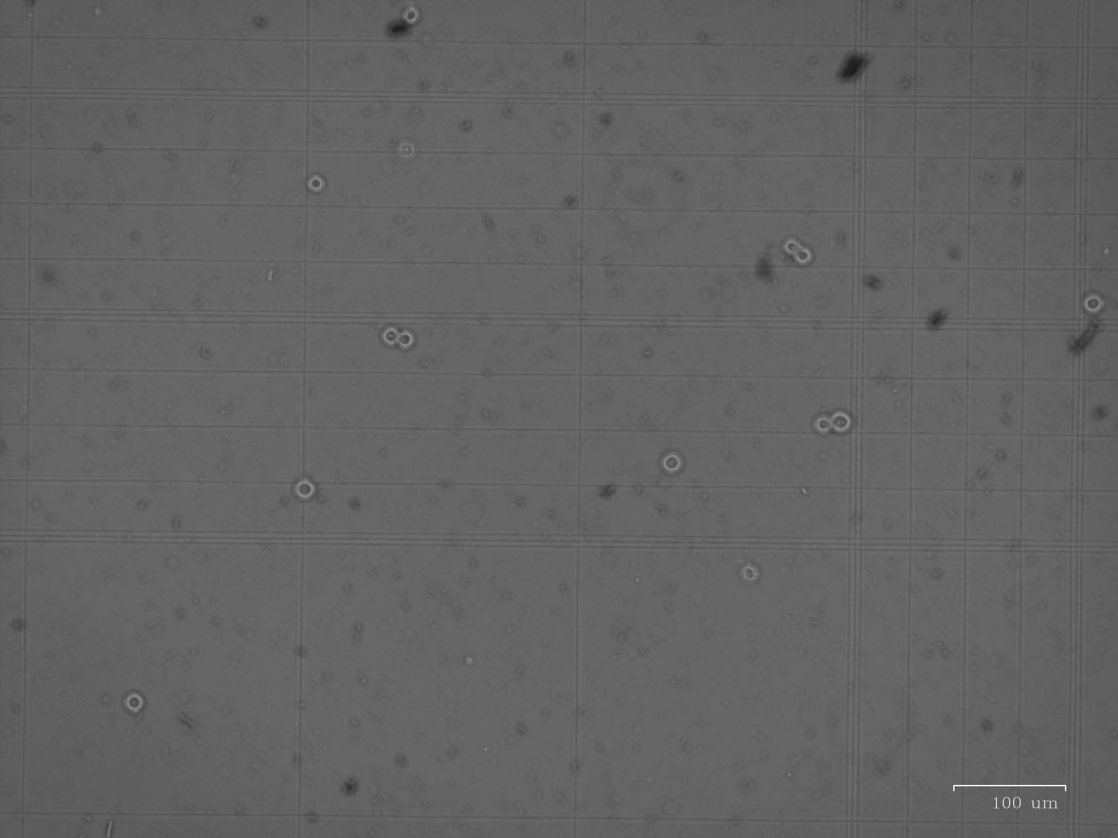
Other pictures (original picture)

Slide 10
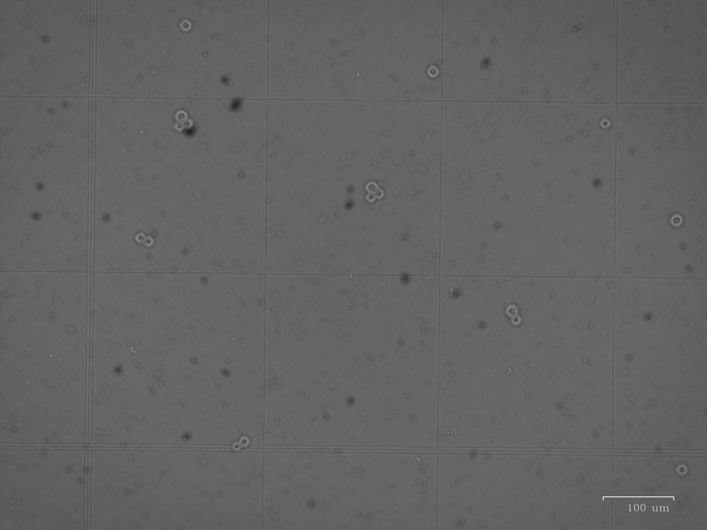
Other pictures (original picture)

